Slide 1
Arrays

Slide 2
Physical Memory
We have to store our data structures in the memory of our computer.
Memory is organized into banks, rows, columns etc.
We supply a bank number, row number etc (= an address), memory returns us the contents
Address → contents

Slide 3
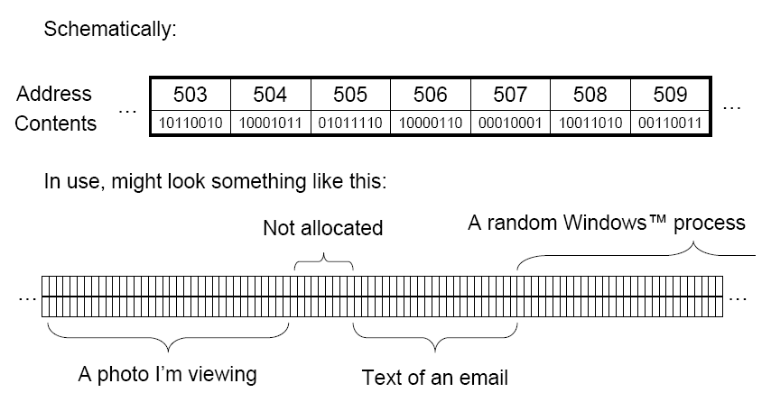
Physical Memory

Slide 4
Arrays
The array is the most commonly used data storage structure; its built into most programming languages.
Since arrays are usually easy to traverse, search and sort, they are frequently used to store relatively permanent collection of data.
But if the size of the structure and the data in the structure is constantly changing, the array may not be useful.
The elements of the array may be denoted by the bracket notation
A[0],A[1], A[2], A[3]…….A[n]

Slide 5
Linear Array
A linear array is a list of finite number “n” of homogeneous data elements such that:
The elements of the array are referenced respectively by an index set consisting of n consecutive numbers.
The elements of the array are sorted respectively in successive memory location.
The number “n” of elements is called the length or size of the array.
Notes:
Definition
An array is simply a number of memory locations, each of which can store an item of data of the same data type and which are all referenced through the same variable name. Ivor Horton.
Array may be defined abstractly as finite order set of homogeneous elements. So we can say that there are finite numbers of elements in an array and all the elements are of same data type. Also array elements are ordered i.e. we can access a specific array element by an index.

Slide 6
Length of the Array
The length or the number of data elements of the array can be obtained by this formula:
Length= UB-LB+1
where:
UB is the largest index, called the upper bound
LB is the smallest index, called the lower bound

Slide 7
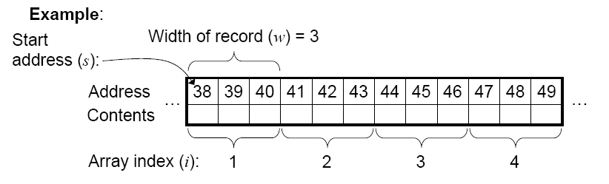
Representation of Linear Arrays in Memory

Slide 8
Arrays in C++
How to declare an array?
The general form of declaring a simple (one dimensional) array is.
array_type variable_name [array size];
In your C++ program you can declare an array like
int Age[10];

Slide 9
Arrays in C++
How to initialize an array?
Declaring and initializing array in one statement.
int Age[5]= {30,22,33,44,26}
Declaring and initializing array separately.
int Age[5];
Age[0]=30; Age[1]=22; Age[2]=33; Age[3]=44; Age[4]=26;
Array can also be initialized in a way that array size is omitted, in such case compiler automatically allocates memory to array
int Age[]={20,22,33,44,26}

Slide 10
Traversing Linear Array
Let A be collection of data elements stored in the memory of the computer.
If we want to count the number of elements of A or we want to print the contents of each element of A, this can be done by traversing A.
Traversing means accessing and processing each element exactly once.
Traversing a linear data structure is easier as compared to traversing a non linear structure.

Slide 11
Algorithm
Here LA is a linear array with lower bound LB and upper bound UB. This algorithm traverses LA applying a PROCESS to each element of LA.
[Initialize counter ] Set K=LB
Repeat Step 3 and 4 while K< UB
[Visit element] Apply PROCESS to LA[K}
[Increase counter] Set K=K+1
[End of Step 2 loop]
Exit
Repeat for K= LB to UB
Apply PROCESS to LA[K}
[End of loop]
Exit
Notes:
main()
{int argc, char** argv
int x[6];
int j;
for(j = 0(LB); j < 6(UB); j++)
x[j] = 2 * j;
}

Slide 12
Exercise
Consider the array AUTO which records the number of automobiles sold each year from 2000 through 2010
Find the number NUM of years during which more than 300 automobiles were sold.
Print each year and the number of automobiles sold in that year.
Notes:
A)
[Initialize counter] Set Num=0
Repeat for K=2000 to 2019
If AUTO[K] >300 then
Set NUM=NUM +1
[End of loop]
Return.
B)
Repeat for K=1932 to 1984
Write K, AUTO[K]
[End of loop]
Return.

Slide 13
Inserting and Deleting
Let A be collection of data elements stored in the memory of the computer.
Inserting refers to the operation of adding another element to the collection A.
Deleting refers to the operation of removing one of the element from A.
Inserting an element at the end of a linear array can be easily done provided the memory space allocated for the array is large enough.

Slide 14
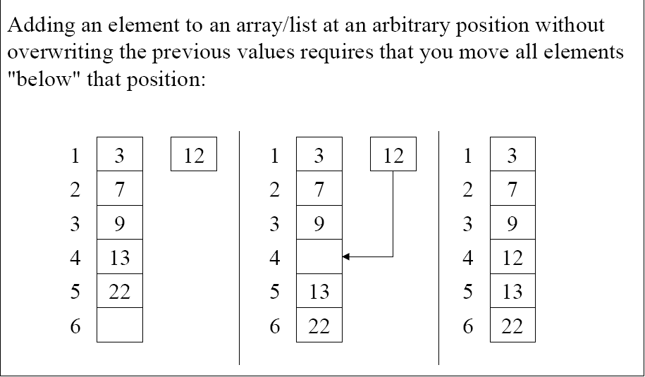
Inserting Elements
Notes:
INSERT
Insert (a, pos, value)
{
if (n==m)
return null;
j=n;
while (j>=pos)
{
a[j+1]=a[j];
j--;
}
a[pos]=value;
n++;
}

Slide 15
Insertion in an array
Let LA is a Linear Array unordered with N elements and K is a positive integer such that K<=N. Below is the algorithm where ITEM is inserted into the K^{th} position of LA .
1.Start
2. Set J=N
3. Set N = N+1
4. Repeat steps 5 and 6 while J >= K
5. Set LA[J+1] = LA[J]
6. Set J = J-1
7. Set LA[K] = ITEM
8. Stop

Slide 16
Example-Dry Run
0
1
2
3
4
5
10
We have to insert 30 at position 2
50
50
25
30
60
60
15
15

Slide 17
Example-Dry Run
J | K
4 | 2
10
1.Start
2. Set J=N
3. Set N = N+1
4. Repeat steps 5 and 6 while J >= K
5. Set LA[J+1] = LA[J]
6. Set J = J-1
7. Set LA[K] = ITEM
8. Stop
50
25
60
LA[4+1]=LA[4]
LA[5]=LA[4]
LA[5]=15
15
15

Slide 18
Example-Dry Run
J | K
4 | 2
3 | 2
1.Start
2. Set J=N
3. Set N = N+1
4. Repeat steps 5 and 6
while J >= K
5. Set LA[J+1] = LA[J]
6. Set J = J-1
7. Set LA[K] = ITEM
8. Stop
0
1
2
3
4
5
10
50
25
LA[3+1]=LA[3]
LA[4]=LA[3]
LA[4]=60
60
15

Slide 19
Example-Dry Run
J | K
4 | 2
3 | 2
2 | 2
1.Start
2. Set J=N
3. Set N = N+1
4. Repeat steps 5 and 6
while J >= K
5. Set LA[J+1] = LA[J]
6. Set J = J-1
7. Set LA[K] = ITEM
8. Stop
0
1
2
3
4
5
10
50
25
60
LA[2+1]=LA[2]
LA[3]=LA[2]
LA[3]=25
60
15
15

Slide 20
Example-Dry Run
J | K
4 | 2
3 | 2
2 | 2
1(loop terminates)
1.Start
2. Set J=N
3. Set N = N+1
4. Repeat steps 5 and 6
while J >= K
5. Set LA[J+1] = LA[J]
6. Set J = J-1
7. Set LA[K] = ITEM
8. Stop
0
1
2
3
4
5
10
50
30
25
60
60
15
LA[K]=ITEM
LA[2]=30
15

Slide 21
Deletion in an array
Consider LA is a linear array with N elements and K is a positive integer such that K<=N. Below is the algorithm to delete an element available at the K^{th} position of LA.
1. Start
2. Set J=K
3. Repeat steps 4 and 5 while J < N
4. Set LA[J] = LA[J+1]
5. Set J = J+1
6. Set N = N-1
7. Stop

Slide 22
Example-Dry Run
1.Start
2. Set J=K
3. Repeat steps 4 and 5 while J < N
4. Set LA[J] = LA[J+1]
5. Set J = J+1
6. Set N = N-1
7. Stop
J | K
2 | 2
0
1
2
3
4
5
10
50
30
25
LA[2]=LA[3]
60
15

Slide 23
Example-Dry Run
1.Start
2. Set J=K
3. Repeat steps 4 and 5 while J < N
4. Set LA[J] = LA[J+1]
5. Set J = J+1
6. Set N = N-1
7. Stop
J | K
2 | 2
3 | 2
0
1
2
3
4
5
10
50
25
LA[3]=LA[4]
60
15

Slide 24
Example-Dry Run
J | K
2 | 2
3 | 2
4 | 2
1.Start
2. Set J=K
3. Repeat steps 4 and 5 while J < N
4. Set LA[J] = LA[J+1]
5. Set J = J+1
6. Set N = N-1
7. Stop
0
1
2
3
4
5
10
50
25
60
LA[4]=LA[5]
15

Slide 25
Example-Dry Run
1.Start
2. Set J=K
3. Repeat steps 4 and 5 while J < N
4. Set LA[J] = LA[J+1]
5. Set J = J+1
6. Set N = N-1
7. Stop
J | K
2 | 2
3 | 2
4 | 2
0
1
2
3
4
5
10
50
25
60
LA[4]=LA[5]
N=4
15

Slide 26
Benefits of Using Array
We can retrieve an array element from its index in constant time, meaning it costs us asymptotically nothing to look up a record.
Consist solely of data, no space wasted on links.
Physical continuity/memory locality: if we look up element i, there is a high probability we will look up element i+1 next

Slide 27
Drawbacks of Using Array
Inflexible: we have to decide in advance how much space we want when the array is allocated. Once the block of memory for the array has been allocated, that’s it –we’re stuck with the size we’ve got.
If we try to write past the end of the array (overflow), we’ll be intruding on memory allocated for something else causing a segmentation fault.
We can compensate by always allocating arrays larger than we think we’ll need, but this wastes a lot of space.

